Slide 1
WELCOME!

Slide 2
Thanks to:
The Public Relations Team of the Vienna University Library
Christina Köstner-Pemsel, Florian Jaksche, Sylvia Nechvatal,
Melanie Klammer, Maria Frenay, Anna-Maria Unterweger
and the Event Management of Vienna University
especially Florian Krug and Valeriya Hamp

Slide 3
Thanks to:
Organizers
Contributing partners

Slide 4
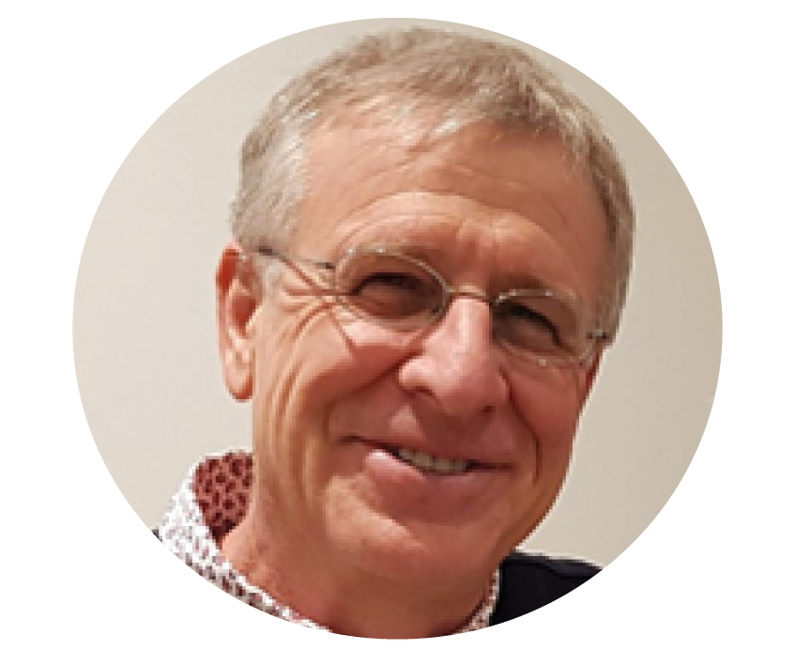
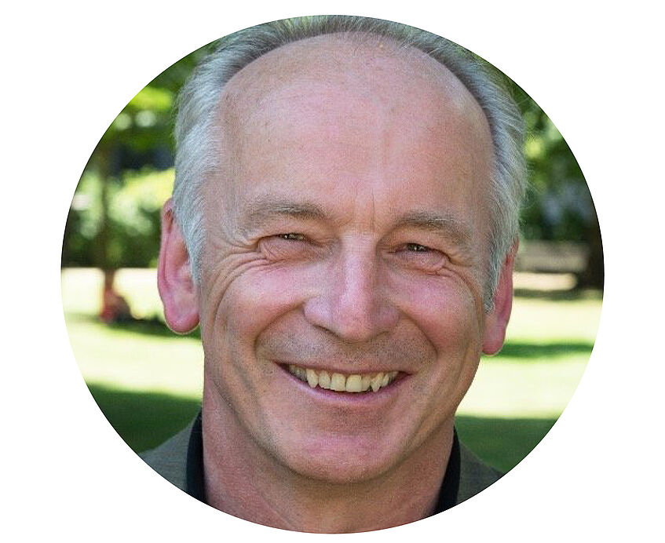
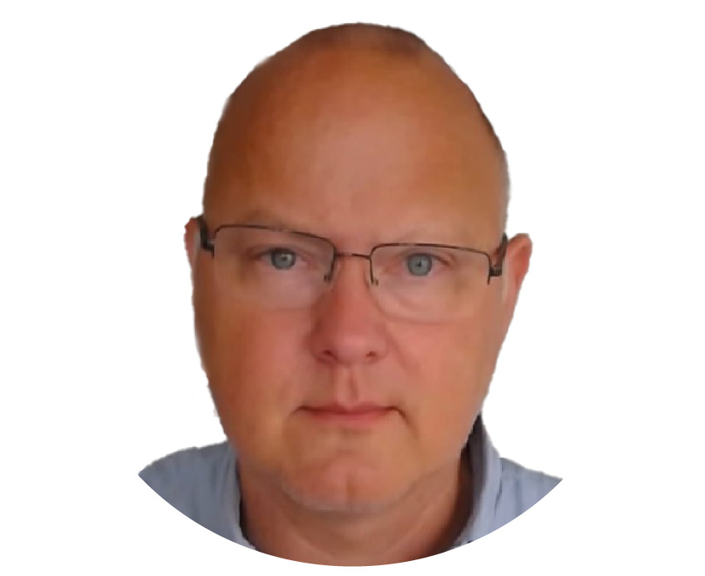
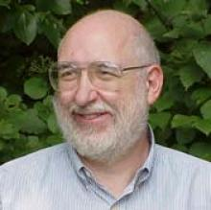
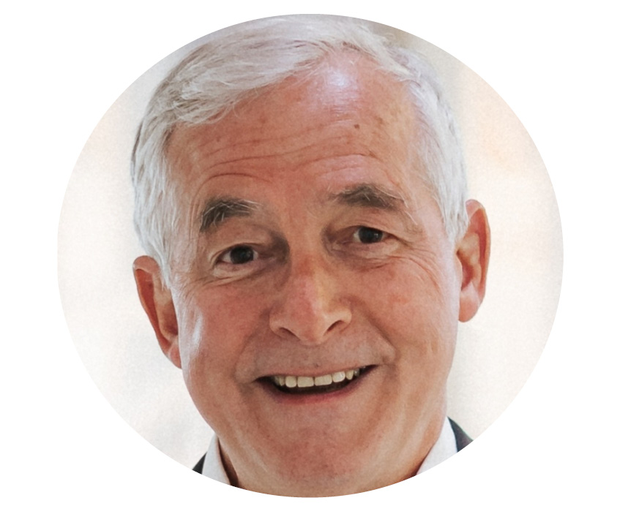
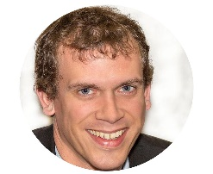
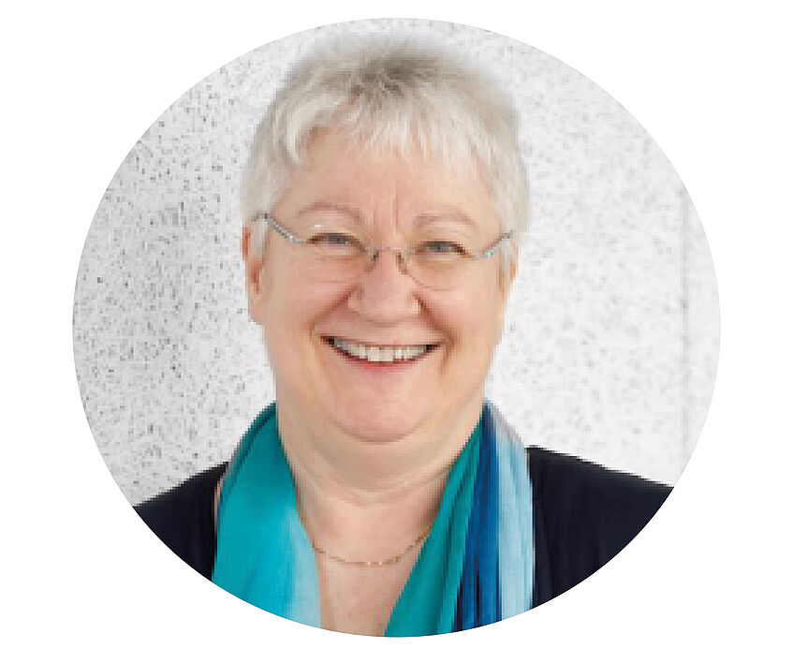
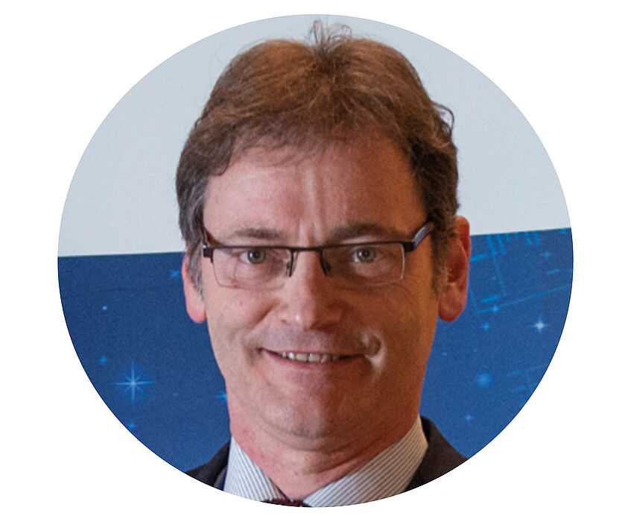
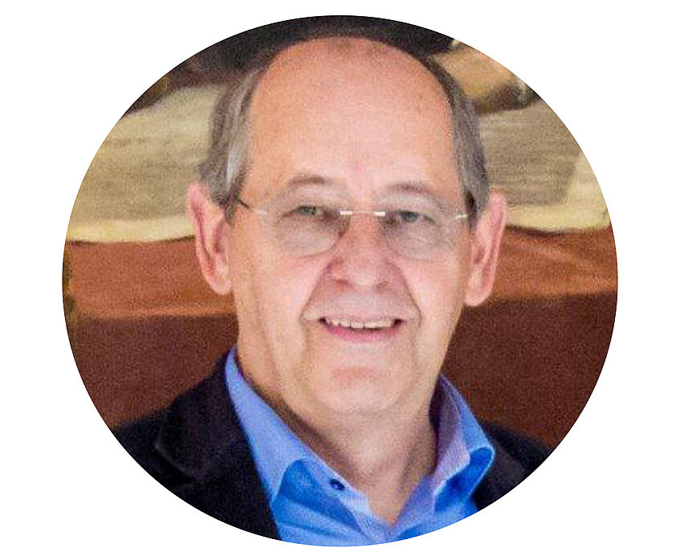
Programme Committee:
Paolo Budroni | Jean-Claude Burgelman | Stefan Hanslik
Larry Lannom | Karel Luyben | Wouter Schallier
Maria Seissl | Michel Schouppe | Peter Wittenburg

Slide 5
Thanks to:
The Editorial Team (Redaktionsteam) at the EOSC Lustrum:
Barbara Sanchez Solis (Coordination)
Miguel Rey Mazon
Juliana De Mello Castro Giroletti
Charlotte Reiff

Slide 6
A note regarding security
In case of emergency:
Please remain calm!
The closest emergency exits are the metal staircases on the outside of the building.
You reach them directly via the emergency doors in the back on the left
or via the foyer where you came in.

Slide 7
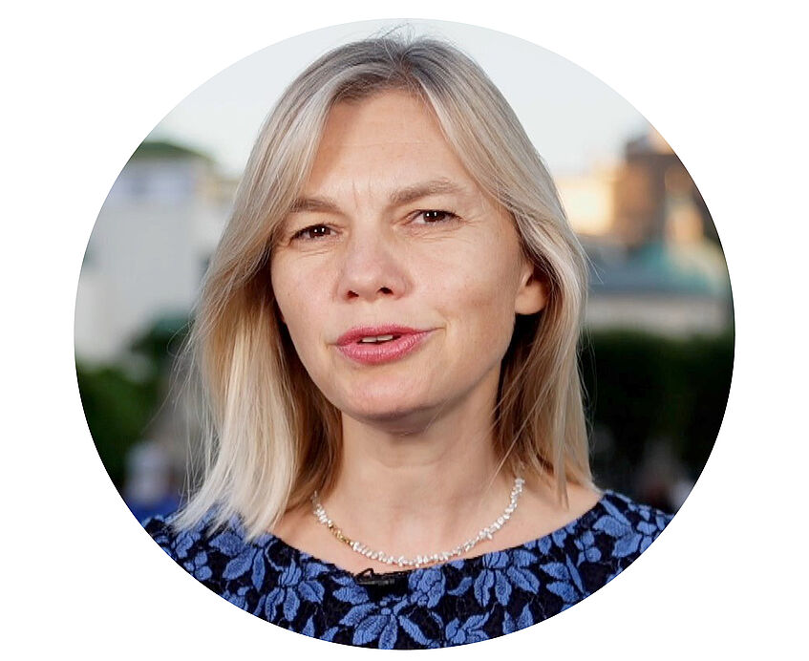
Host of the Event: Bethany Bell

